Slide 1
Humans of Our Place
Add a slide for your partner after the sample slides. Delete the sample slides once everyone is done. Be sure to give yourself credit for your interview by putting By: Your Name under the slide of your partner.

Slide 2
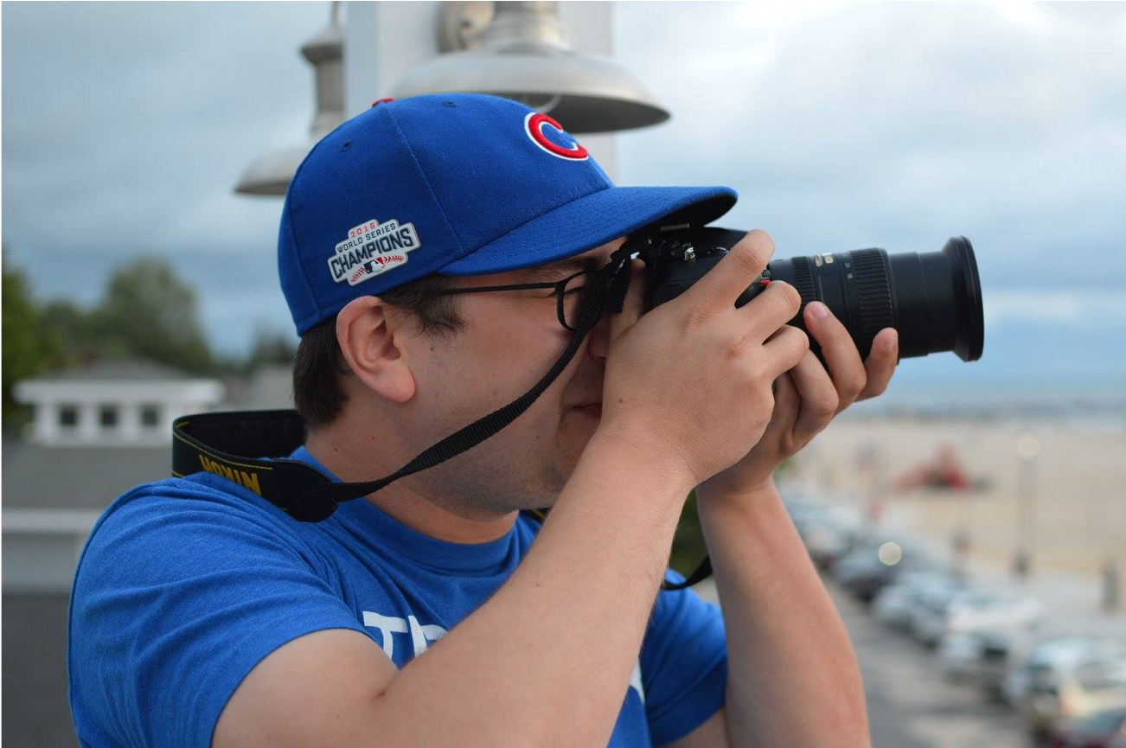
“It’s just fascinating to me how [...] different people can be in the same setting and capture different images, and think about what they’re seeing in different ways, so I just love taking photos.”
-Scott Girard, Cap Times
Youth Press Corps Facilitator
by Laura Streyle

Slide 3
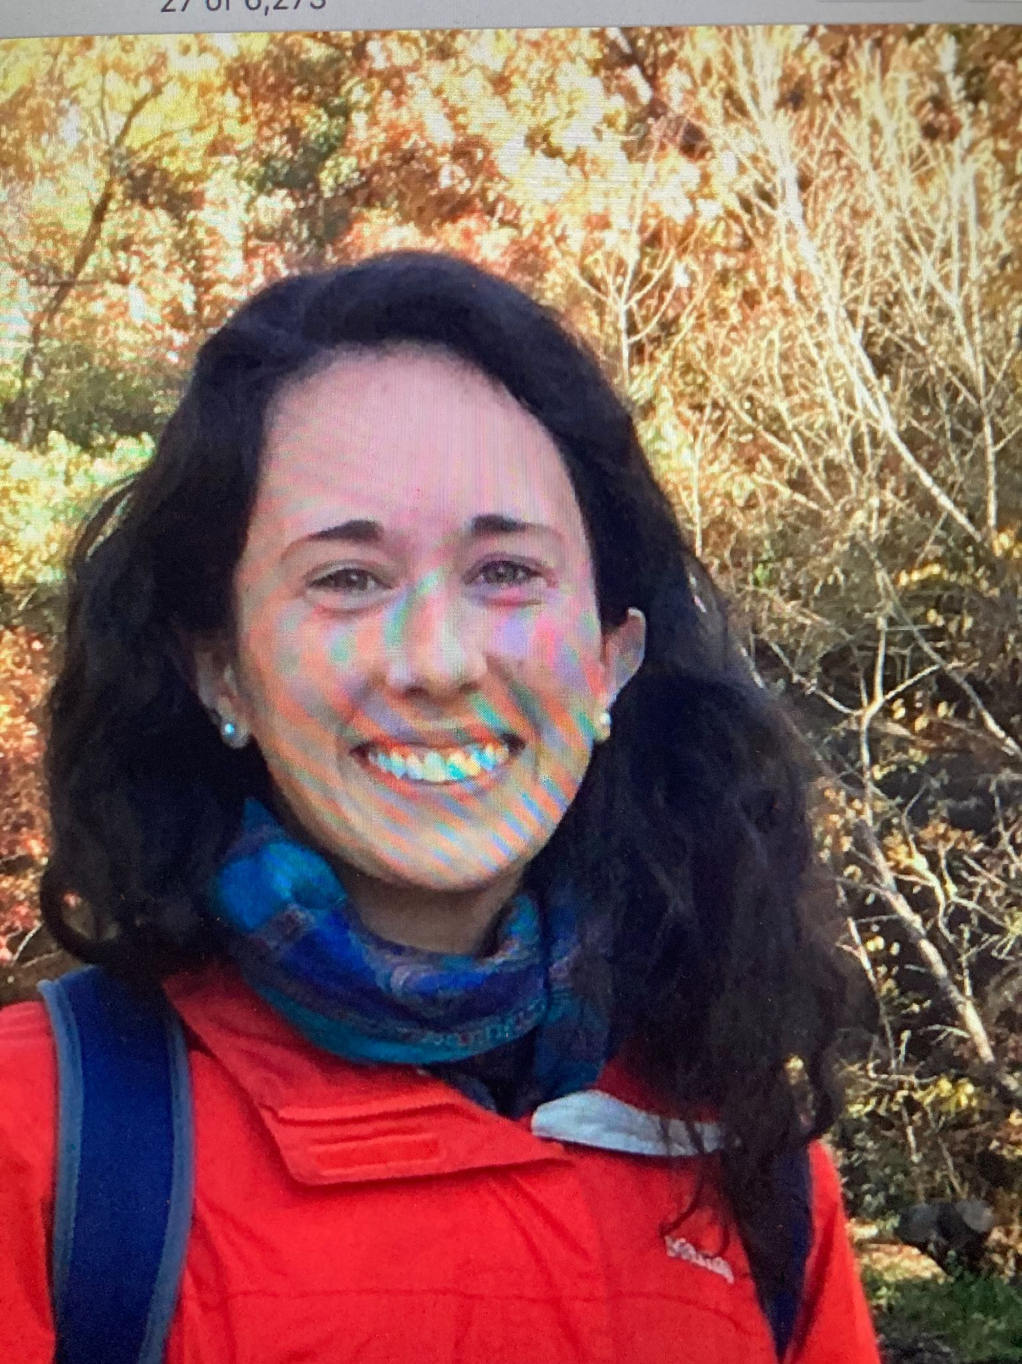
“I really need to write to understand my thoughts, so that’s something I’m passionate about. [...] It’s just kind of my thinking, but I still find it very important. […] [It’s] kind of hard, but I’m passionate about writing anything.”
-Laura Streyle, Madison, Wisconsin
by Name Here

Slide 4
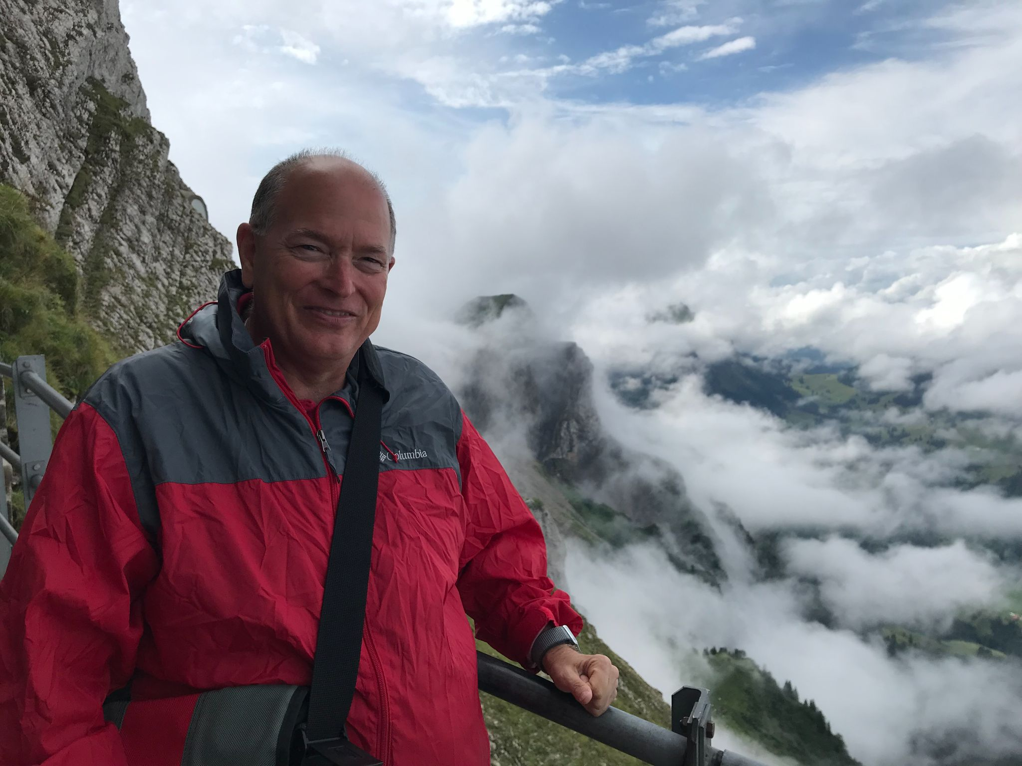
“I retired after a 30-year career of teaching. And there are some things I really enjoy about retirement, but things I really miss about teaching, as well. And one of the things that I miss, every day and probably for the rest of my life, is the chance for daily interaction with students. It always gave me joy.”
-Mark Nepper, Teacher of 30 years at West High School
Youth Press Corps Facilitator by Laura Streyle

